Slide 1

Computer Networks
CET2005B
School of Computer Engineering and Technology (SCET)

Slide 2

Unit V : Application Layer

Slide 3
Contents
Hypertext Transfer Protocol (HTTP)
Domain Name System (DNS)
Dynamic Host Control Protocol (DHCP)
Simple Mail Transfer Protocol: POP3 (Post Office Protocol 3), IMAP(Internet Message Access Protocol), MIME (Multipurpose Internet Mail Extension )
File Transfer Protocol (FTP)
TELNET
Simple Network Management Protocol (SNMP)

Slide 4
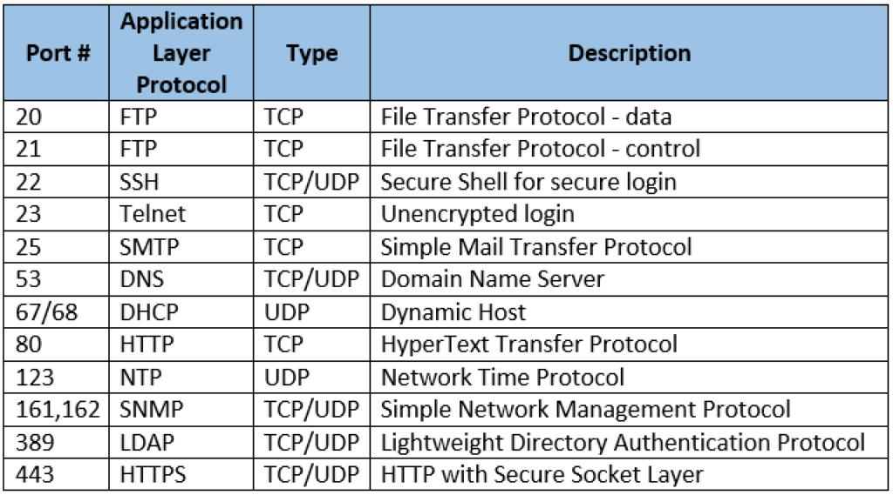
Port numbers :Application layer protocols

Slide 5
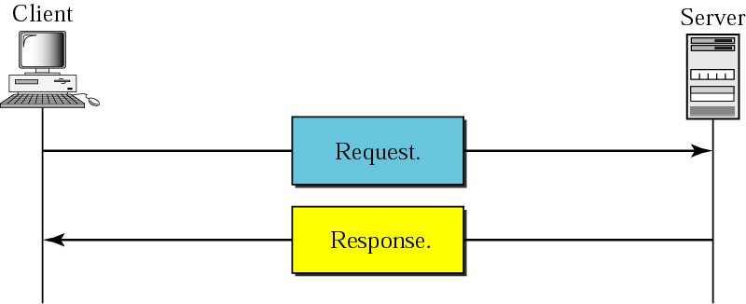
Hypertext Transfer Protocol (HTTP)
The Hypertext Transfer Protocol (HTTP) is a protocol used mainly to access data on the World Wide Web.
HTTP layered over bidirectional byte stream:
Almost always use TCP
Interaction:
Client sends request to server, followed by response from server to client
Requests/responses are encoded in text
Stateless:
Server maintains no information about past client requests
HTTP uses the services of TCP on well-known port 80

Slide 6
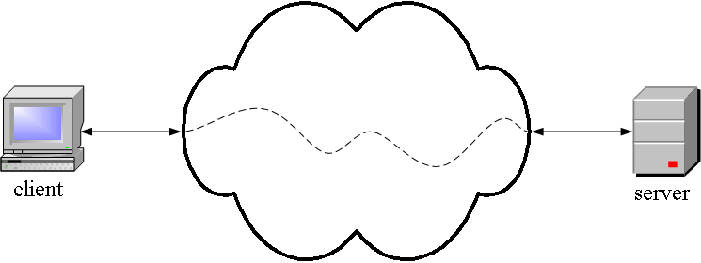
Hypertext Transfer Protocol (HTTP)
HTTP is an application layer protocol
The Web client and the Web server are application programs.
Application layer programs do useful work like retrieving Web pages, sending and receiving email or transferring files.

Slide 7
Hypertext Transfer Protocol (HTTP)
Lower layers take care of the communication details
In Application Layer: The client and server send messages and data without knowing anything about the communication network.

Slide 8
HTTP Transaction
HTTP uses the services of TCP
HTTP itself is a stateless protocol, which means that the server does not keep information about the client.
The client initializes the transaction by sending a request. The server replies by sending a response.

Slide 9
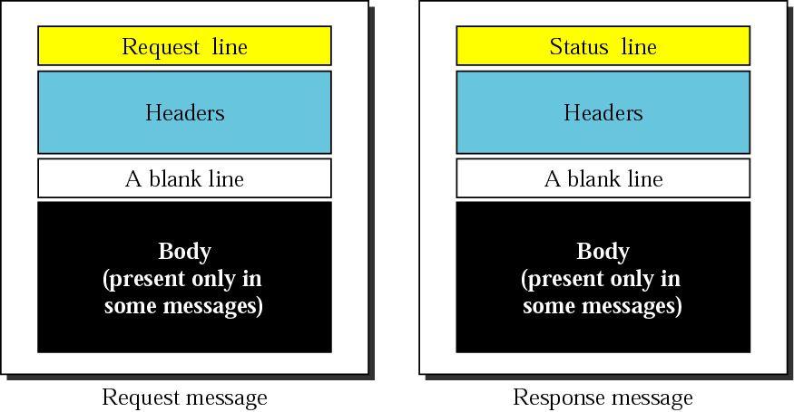
HTTP request and response messages
Figure: HTTP request and response message format

Slide 10
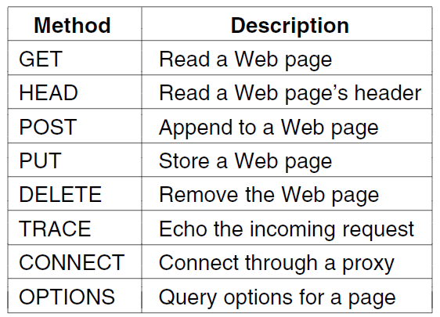
Built-in HTTP Request Methods/Commands
Figure : Built-in HTTP request methods

Slide 11
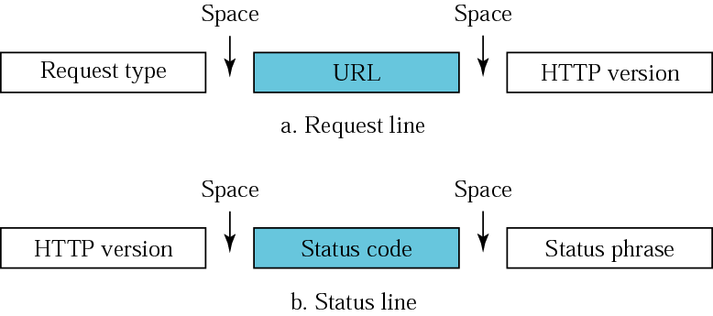
HTTP Request and Status line
An HTTP Request and Response/status is divided into three parts:
HTTP/0.9, HTTP/1.0, HTTP/1.1, and HTTP/2.0.
HTTP Request Type:, GET, PUT, POST, HEAD or OPTIONS)
status code of 200 (OK).
HTTP Status Lines
(HTTP Status Codes + HTTP Reason Phrases)
Figure: HTTP request and status line

Slide 12
Built-in HTTP request methods
GET: The HTTP GET method is used to read (or retrieve) a representation of a resource. GET returns a representation in JSON and an HTTP response status code of 200 (OK). In an error case, it most often returns a 404 (NOT FOUND) or 400 (BAD REQUEST).
HEAD: HEAD is Same as GET, but transfers the status line and header section only.
POST: The POST method is most often utilized to create new resources. In particular, it is used to create subordinate resources. That is subordinate to some other (e.g. parent) resource.
PATCH: PATCH is used to modify resources. The PATCH request only needs to contain the changes to the resource, not the complete resource.
Figure : Built-in HTTP request methods

Slide 13
Built-in HTTP request methods
PUT: PUT Replaces all current representations of the target resource with the uploaded content.
DELETE: DELETE is quite easy to understand. It is used to delete a resource identified by filters or ID. On successful deletion, the HTTP response status code 204 (No Content) returns with no response body.
TRACE: TRACE Performs a message loop-back test along the path to the target resource.
CONNECT: CONNECT Establishes a tunnel to the server identified by a given URI.
OPTIONS: OPTIONS Describes the communication options for the target resource.
Figure : Built-in HTTP request methods

Slide 14
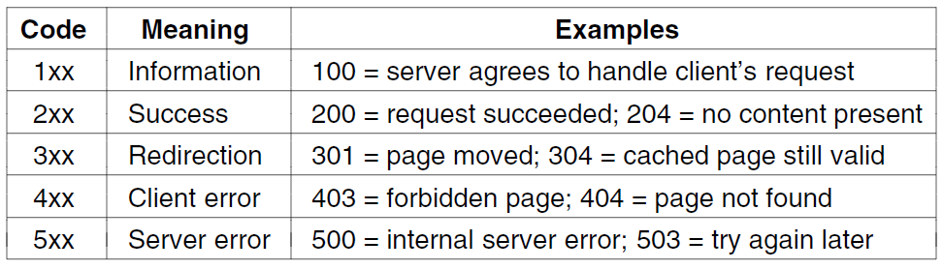
HTTP Status Code response groups
Status codes are issued by a server in response to a client's request made to the server.
The first digit of the status code specifies one of Five standard classes of responses.
The Internet Assigned Numbers Authority (IANA) maintains the official registry of HTTP status codes
Figure : HTTP status code response groups

Slide 15
HTTP status code response groups cont
1xx: informational response – the request was received, continuing process
2xx: successful – the request was successfully received, understood, and accepted
3xx: redirection – further action needs to be taken in order to complete the request
4xx: client error – the request contains bad syntax or cannot be fulfilled
5xx: server error – the server failed to fulfil an apparently valid request

Slide 16
Difference between HTTP non-persistent and persistent connection
Non-persistent Connection | Persistent Connection
In a non-persistent connection, one TCP connection is made for each request/response. | The server leaves the connection open for more requests after sending a response.
HTTP version 1.0. The client opens a TCP connection and sends a request. The server sends the response and closes the connection. | HTTP version 1.1 specifies a persistent connection by default.
The client reads the data until it encounters an end-of-file marker; it then closes the Connection. | Server can close the connection at the request of a client or if a time-out has been reached.
Ex. IRCTC, Banking (Terminate connection after closing application) | Ex. Gmail (connection Remain present even closing application)

Slide 17
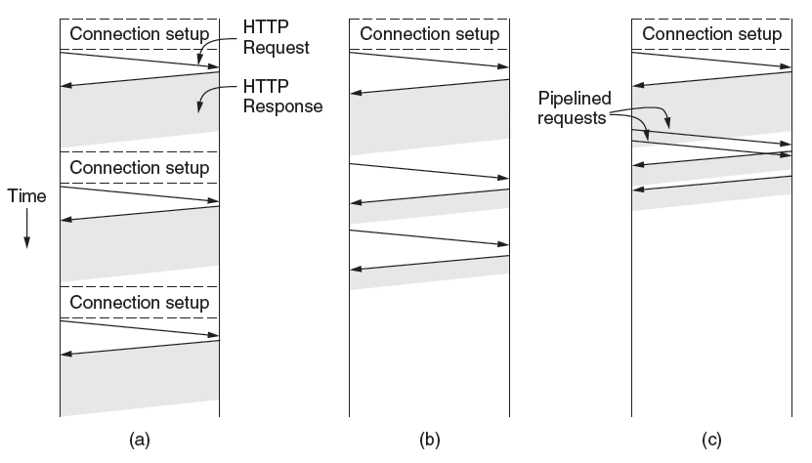
HTTP connections and requests
Figure : HTTP with (a) Multiple connections and sequential requests.
(b) A persistent connection and sequential requests.
(c) A persistent connection and pipelined requests.

Slide 18
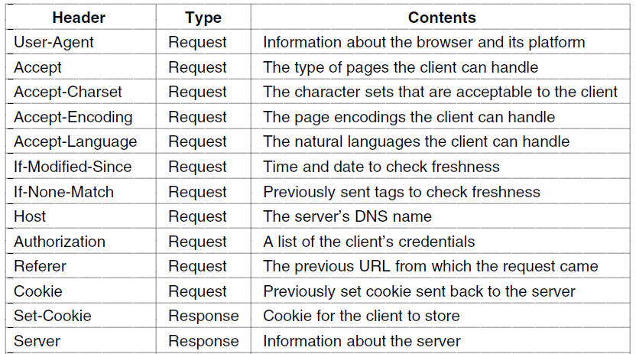
HTTP Message Headers
HTTP header fields are a list of strings sent and received by both the client program and server on every HTTP request and response. These headers are usually invisible to the end-user and are only processed or logged by the server and client applications.
Figure : Some HTTP message headers

Slide 19
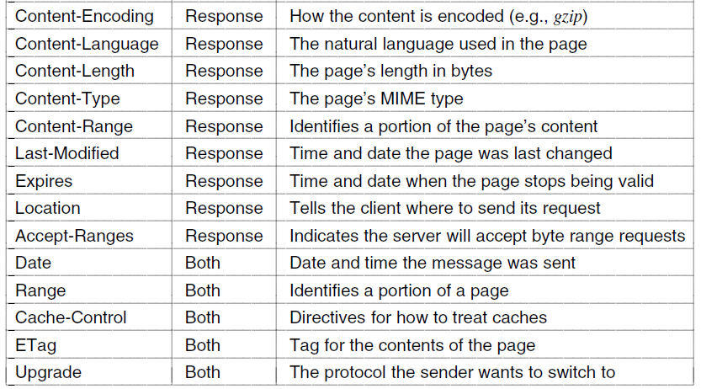
HTTP message headers
Figure : Some HTTP message headers

Slide 20
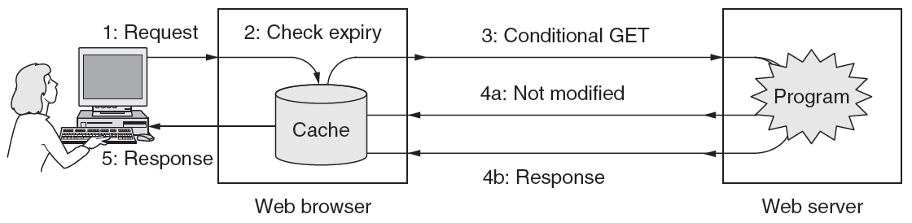
HTTP Caching
Caching is a technique that stores a copy of a given resource and serves it back when requested. When a web cache has a requested resource in its store, it intercepts the request and returns a copy of the stored resource instead of redownloading the resource from the originating server.
The HTTP Cache is an effective way to improve load performance because it reduces unnecessary network requests.
Figure : HTTP caching

Slide 21
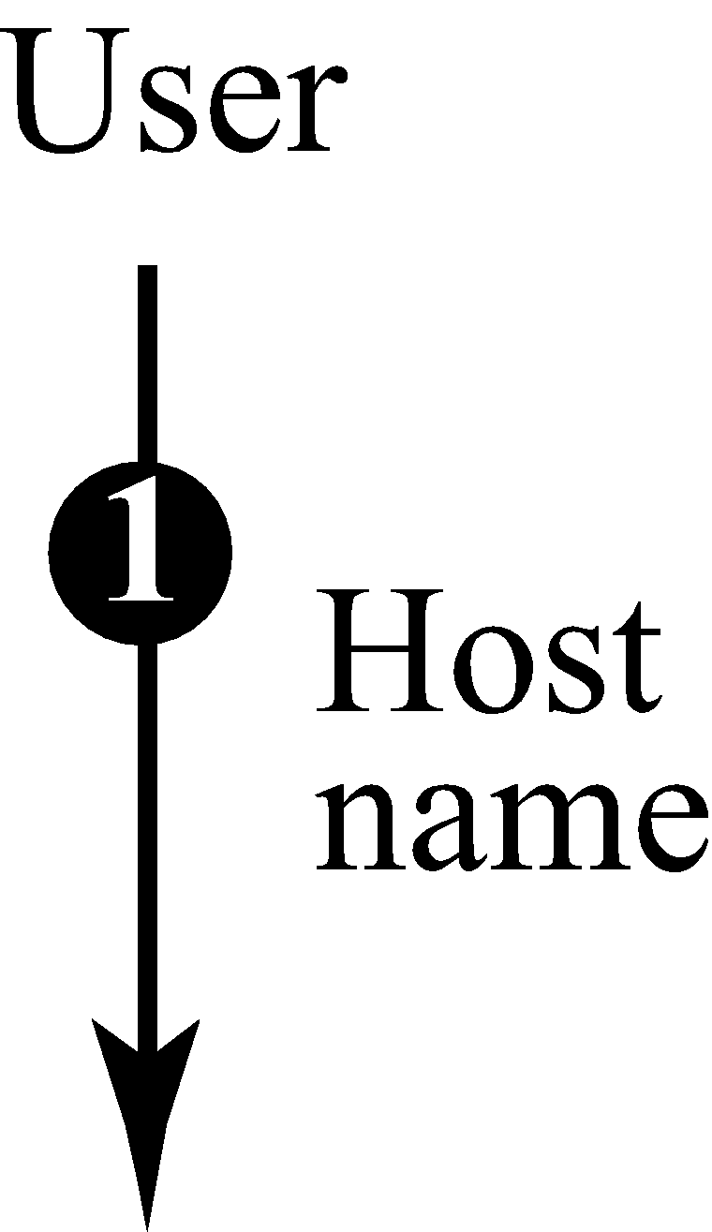
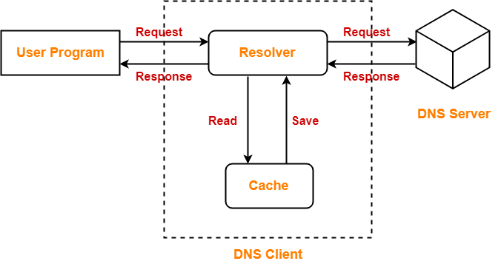
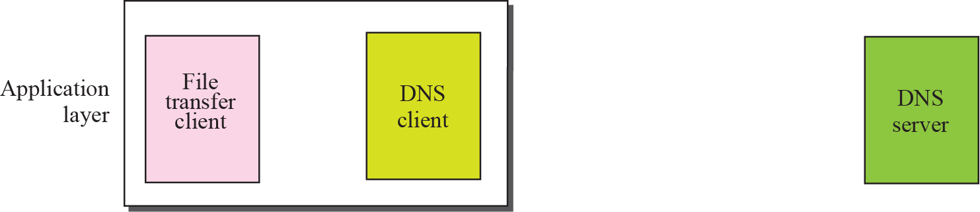
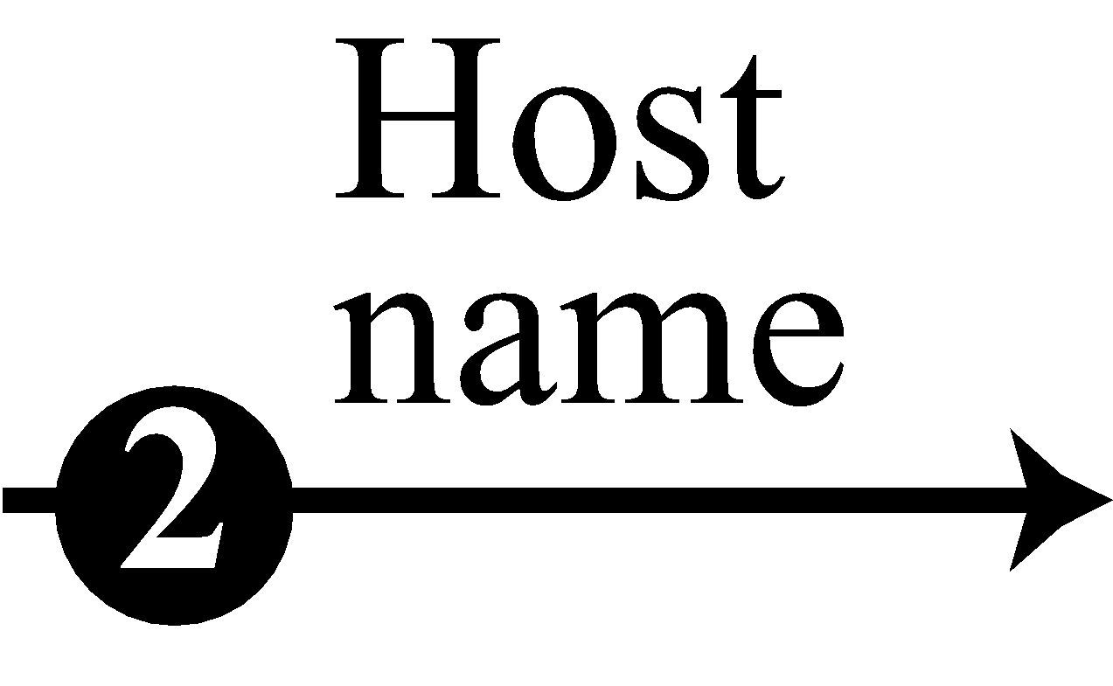
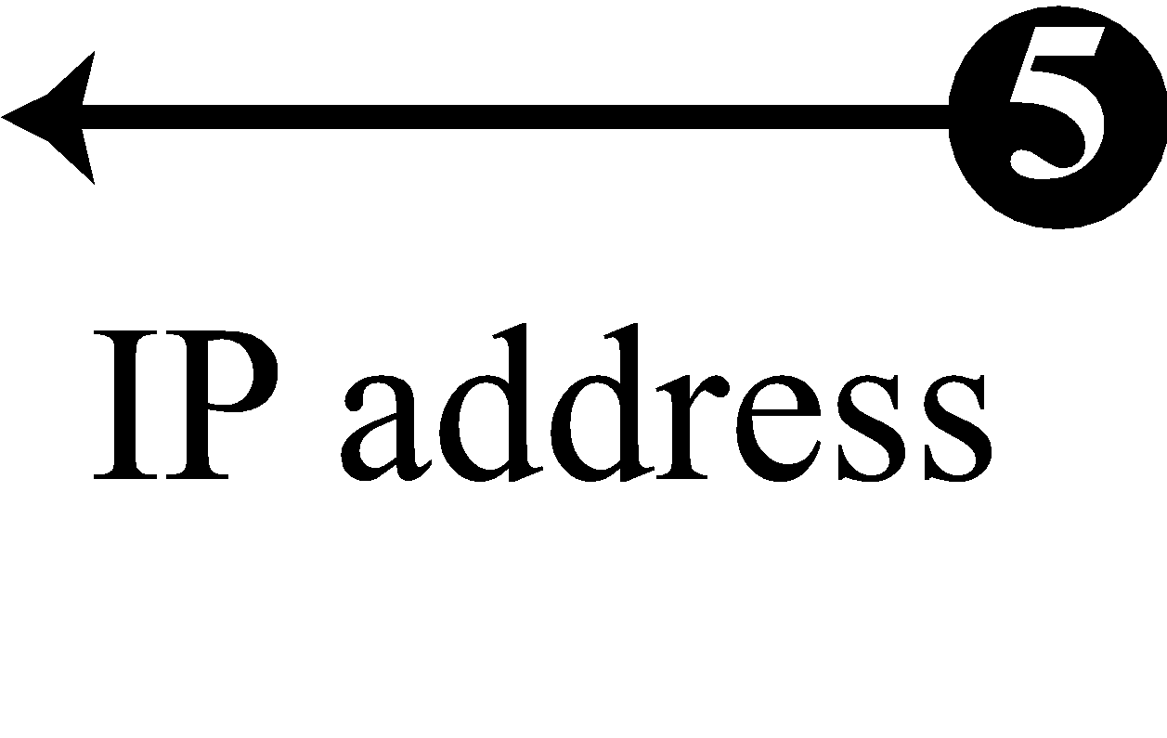
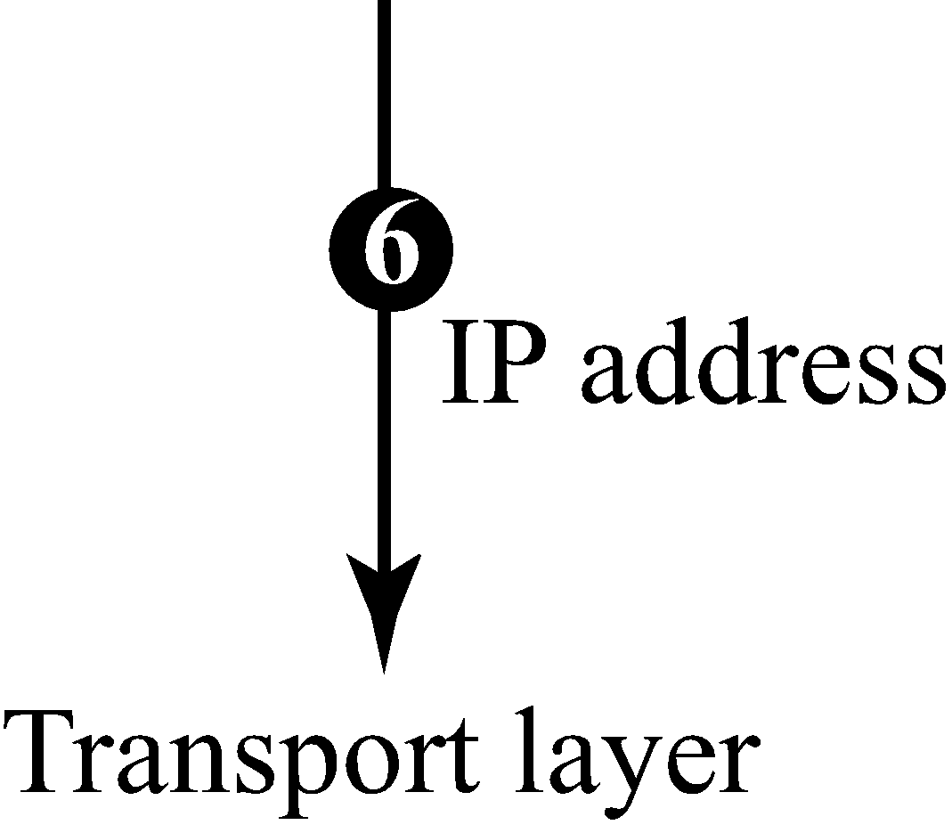
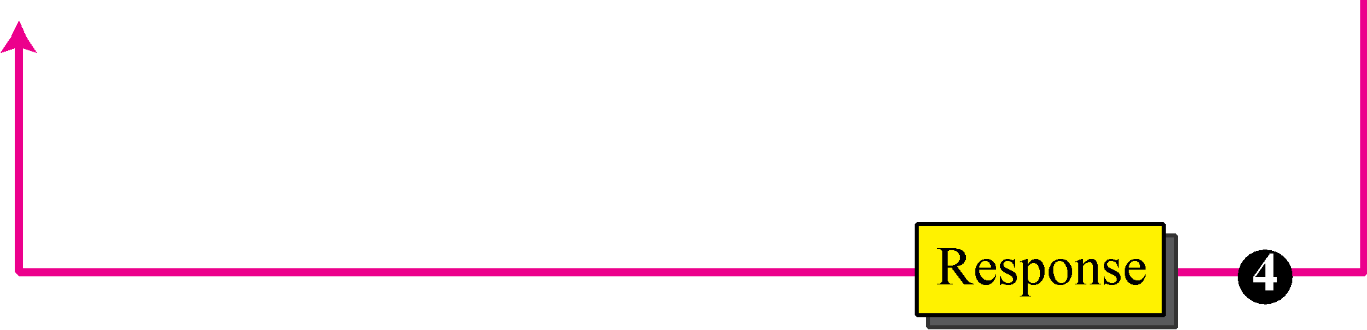
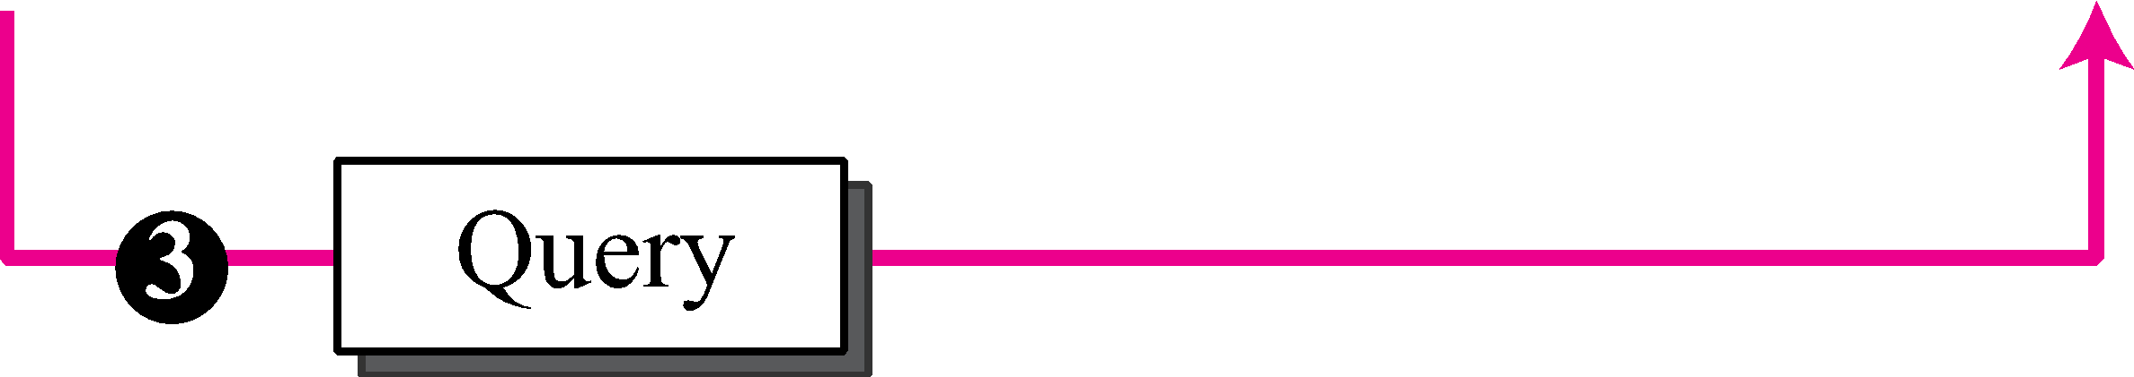
Domain Name System (DNS)
69.63. 176.13
Facebook

Slide 22
Domain Name System (DNS)
Need for DNS:
To identify an entity, TCP/IP protocols use the IP address, which uniquely identifies the connection of a host to the Internet. However, people prefer to use names instead of numeric addresses. Therefore, we need a system that can map a name to an address or an address to a name. (Map IP address with Domain Names)
Name Space:
To be unambiguous, the names assigned to machines must be carefully selected from a name space with complete control over the binding between the names and IP addresses. In other words, the names must be unique because the addresses are unique.
A name space that maps each address to a unique name can be organized in two ways:
Flat or Hierarchical.

Slide 23
Domain Name System (DNS)
DNS can use the services of UDP using the well-known port 53
The DNS name space
Domain Resource records
Name servers
Real time example: Phone Book. We cant remember phone numbers but by person names we can remember.
Ex: 52.19.167.6
cricinfo ip address (for cricket lovers)

Slide 24
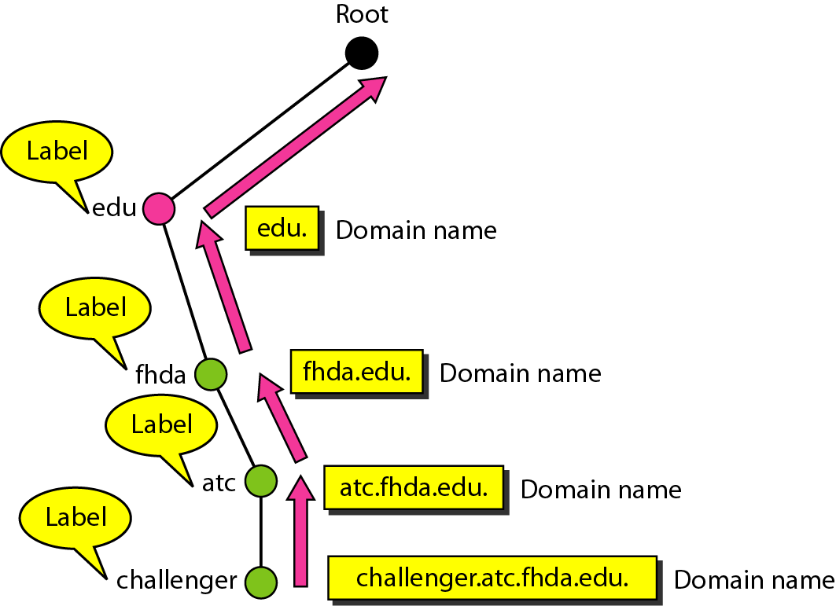
Domain names and labels
Server
Role of Cache is to store web pages and taken care by ISP
Figure : Domain names and labels

Slide 25
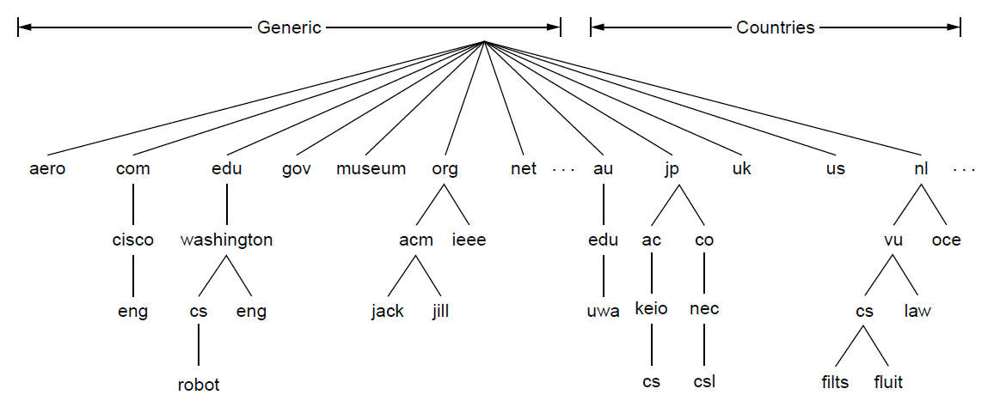
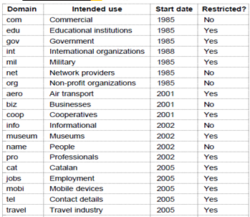
A portion of the internet domain name space
Figure : A portion of the internet domain name space

Slide 26
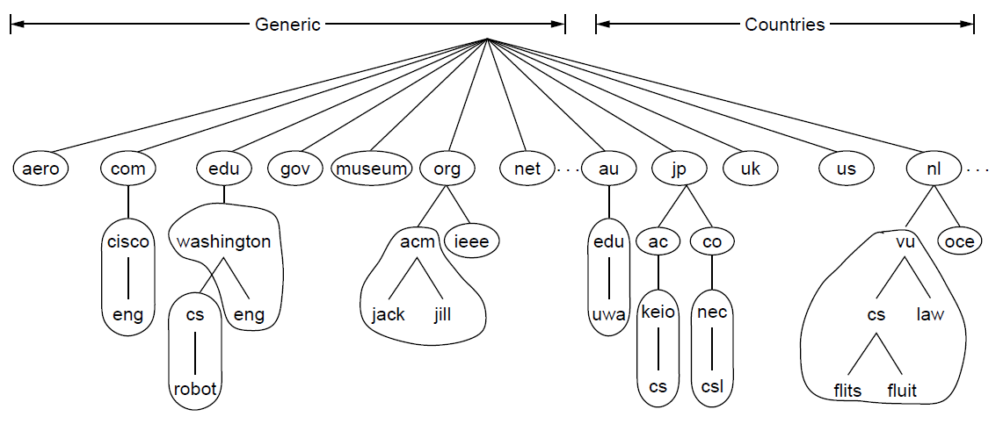
Part of the DNS name space divided into zones
Figure : Part of the DNS name space divided into zones (which are circled).

Slide 27
Generic top-level domains
Figure : Generic top-level domains

Slide 28
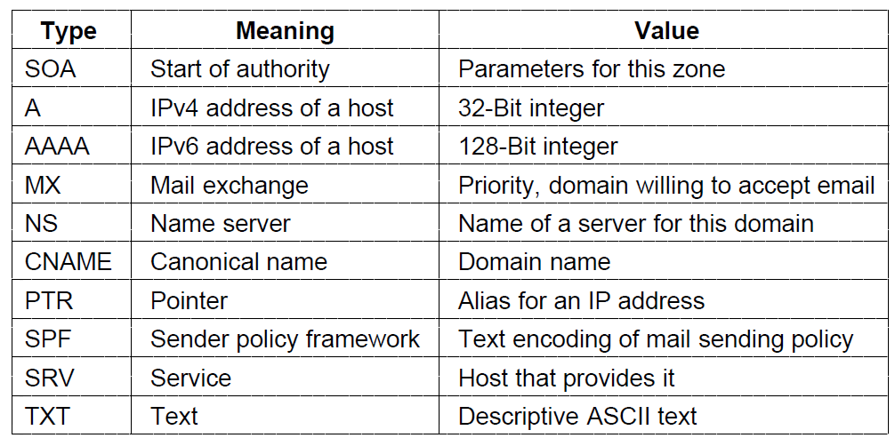
Domain resource records
Figure : Principal DNS resource record types

Slide 29
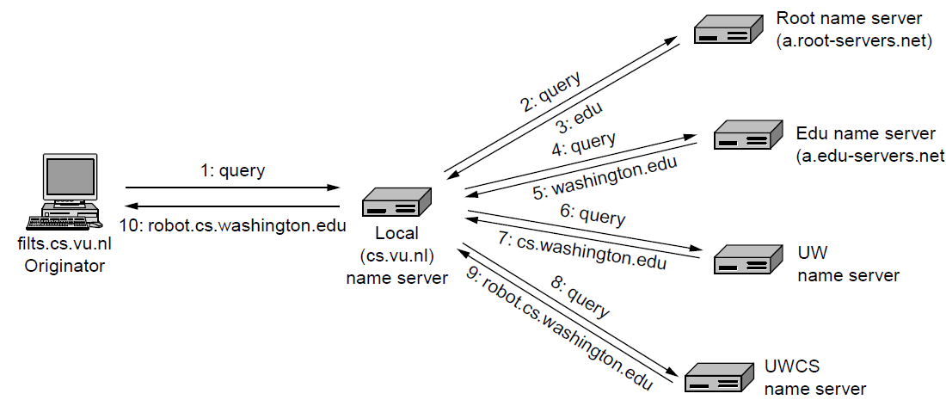
Example of a resolver looking up a remote name in 10 steps
Top level Domain server
Local cache/ DNS resolver
Actual IP addresses present in Autoreactive severs
Figure : Example of a resolver looking up a remote name in 10 steps

Slide 30
Quiz:
Port No:
HTTP----
80
DNS----
53
Non-persistent Connection HTTP version
1.0
persistent Connection HTTP version
1.1
DNS uses witch services of UDP or TCP?
UDP
HTTP Request Type:, GET, PUT, POST, HEAD or OPTIONS) - True or False

Slide 31
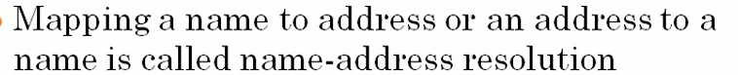
Resolution
Mapping a name to an address or an address to a name is called name-address resolution
1. Recursive Resolution
2. Iterative Resolution
Figure : Recursive resolution

Slide 32
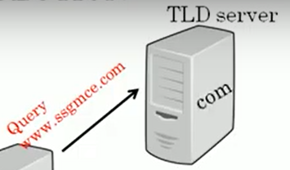
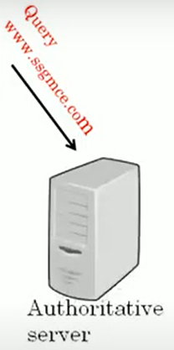
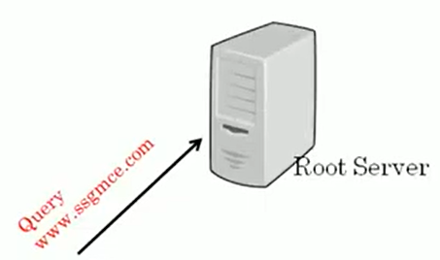
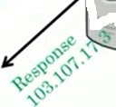
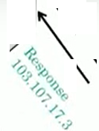
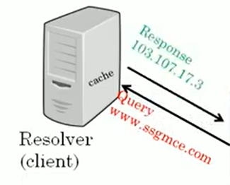
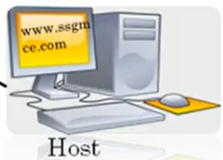
Recursive Resolution (IP Address should take from Root Server)
5. Root Server forward Query to Top Level Domain server i.e. .com server
Top Level Domain Server
4. If IP add not found, Resolver will forward .com Query to Root server
6. This AS contain mapping table which converts domain name into IP address
3. If It finds IP address, send IP address back to the host called caching
1. Host want to access website from some server like www.ssgmce.com. So host will need IP address.
2. Host send Query Message to DNS resolver. Will search for corresponding IP address into its own cache memory.
Figure : Recursive resolution

Slide 33
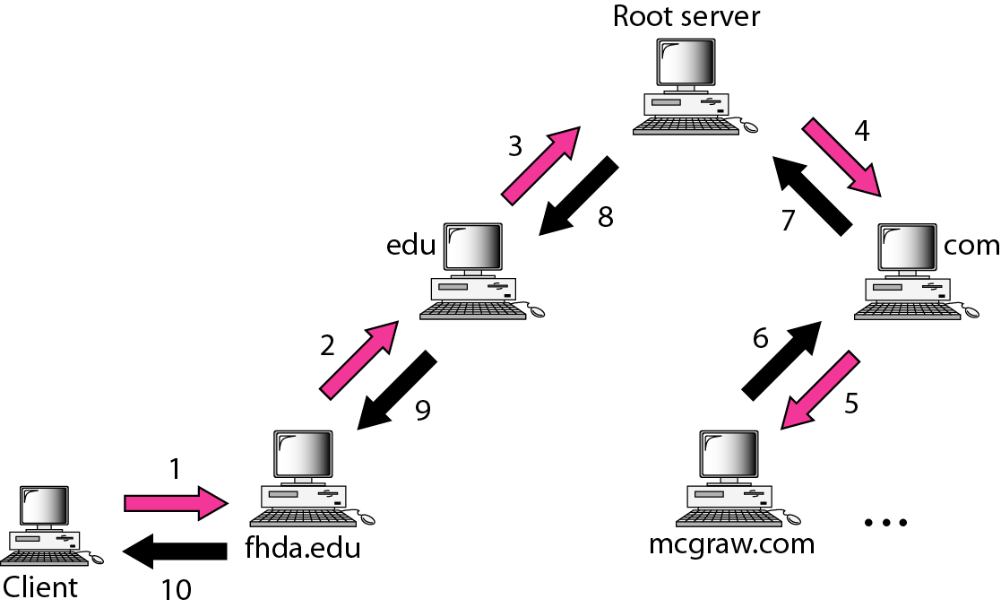
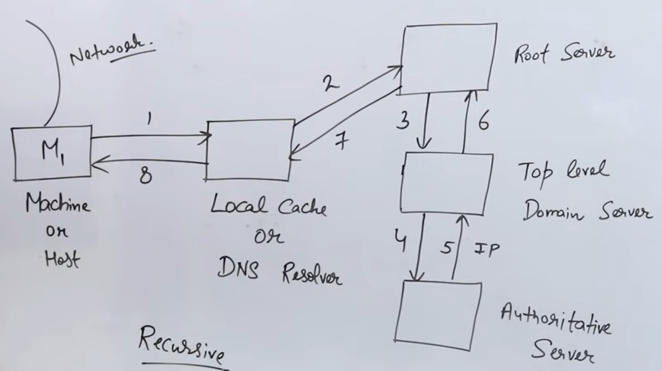
Recursive Resolution (Extra)
Mapping a name to an address or an address to a name is called name-address resolution
Figure : Recursive resolution

Slide 34
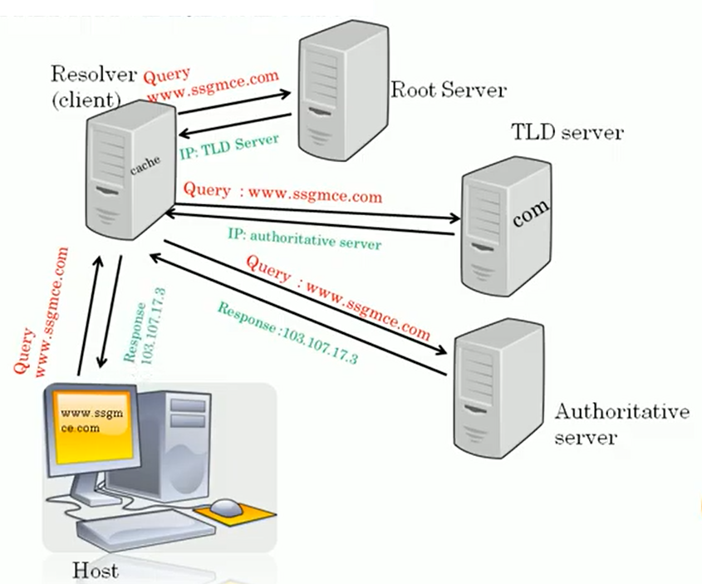
Iterative Resolution
In this, resolver has to send repeatedly query message to the different servers. Hence called as IR
Figure : Iterative resolution

Slide 35
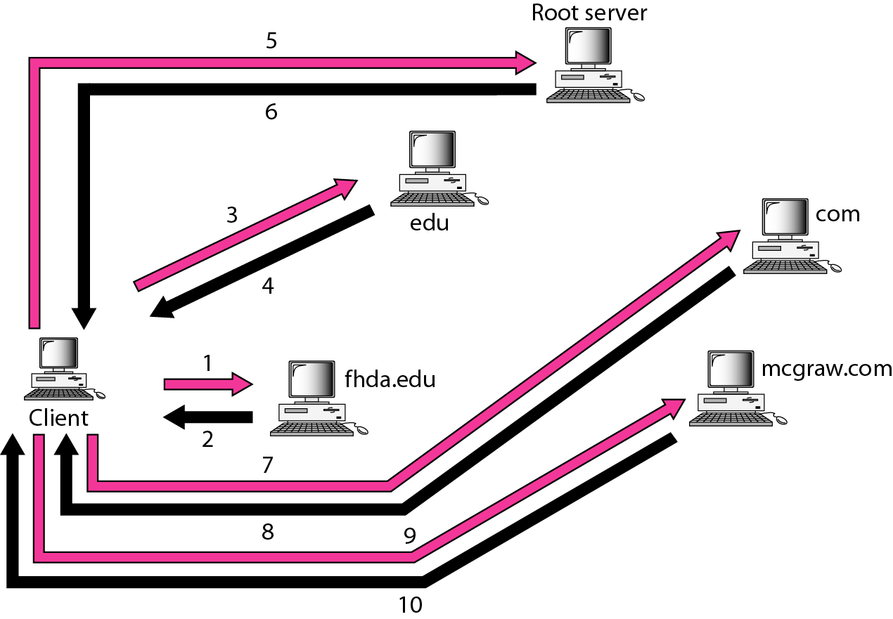
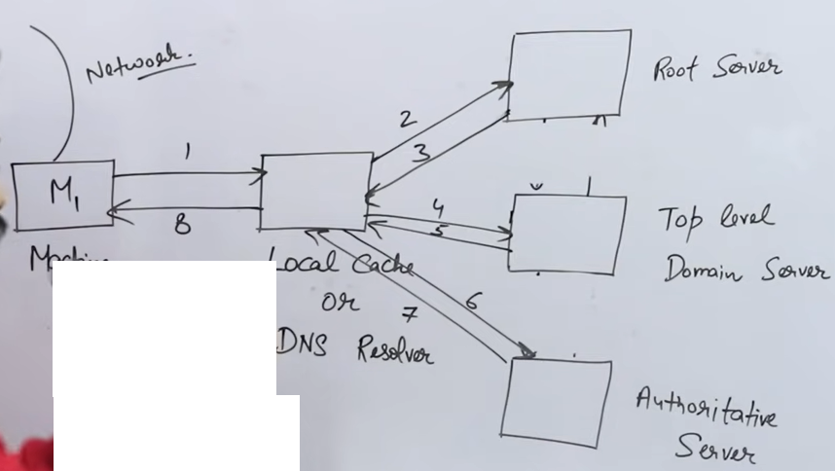
Iterative resolution (Extra)
Figure : Iterative resolution

Slide 36
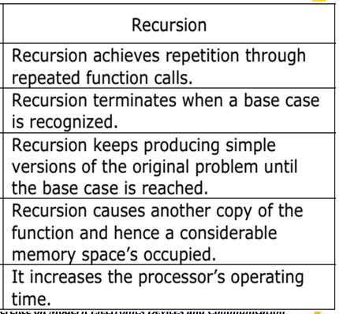
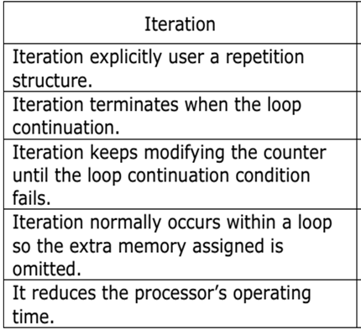
Difference Between Recursive and Iterative Resolution

Slide 37
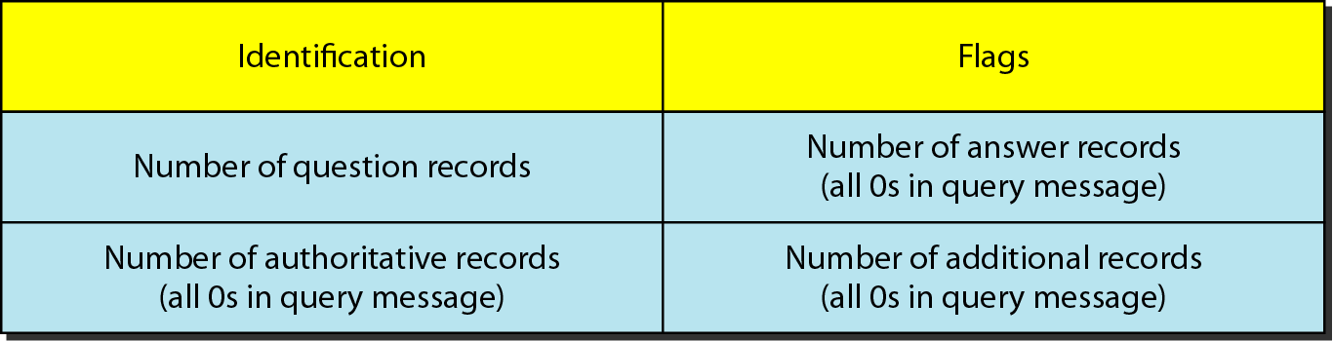
Header Format
Both query and response messages have the same header format with some fields set to zero for the query messages. The header is of 12 bytes.
Identification: for matching response to queries
Flags: specifies the requested operation and a response code
Questions: count of entries in the queries section
Answer RRs: count of entries in the answers section (RR stands for “resource record”)
Authority RRs: count of entries in the authority section
Additional RRs: count of entries in the additional section
Queries: queries data
16 Bit
16 Bit
Figure : DNS query and response message header format

Slide 38
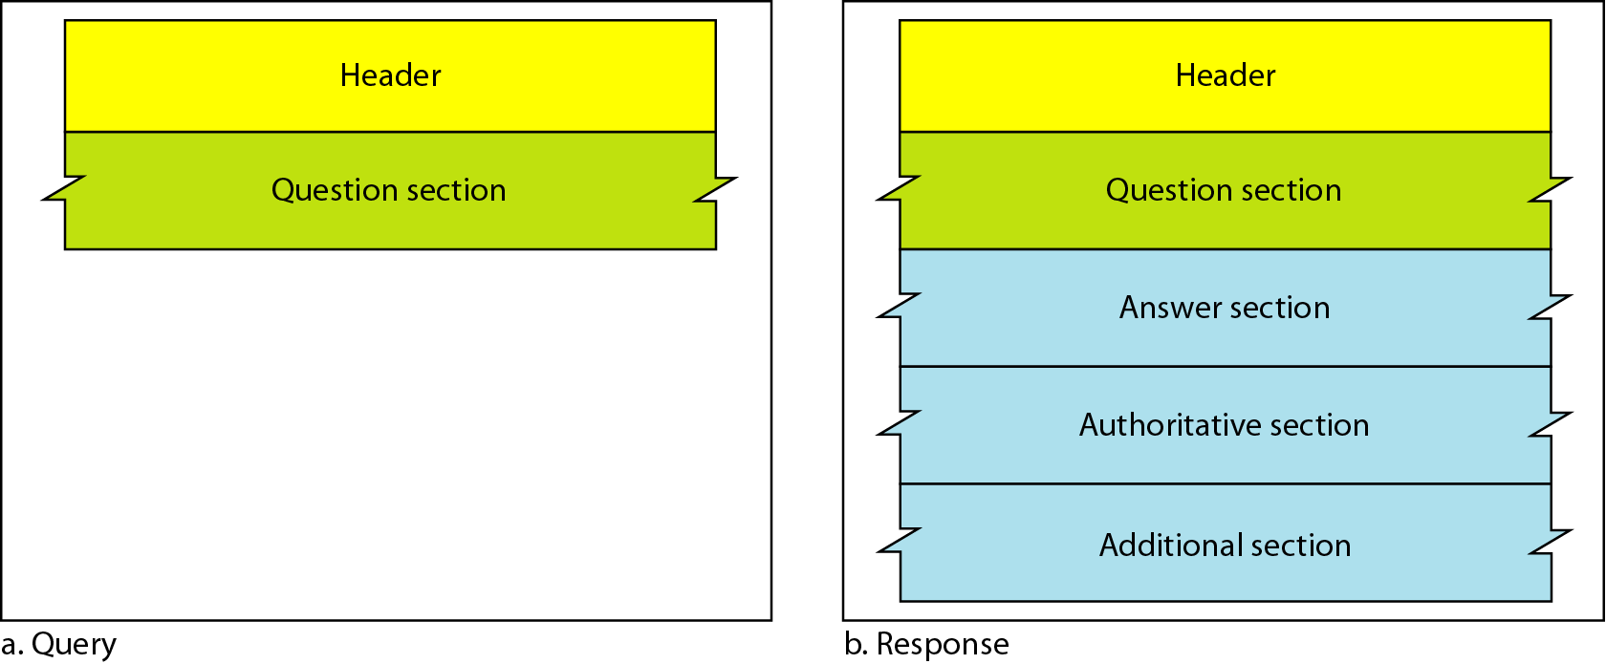
DNS Messages: 2 Types
The DNS protocol uses two types of DNS messages : 1. Query 2. Response
Both types have the same format. The query and Response message consists of:
Figure : DNS query and response messages

Slide 39
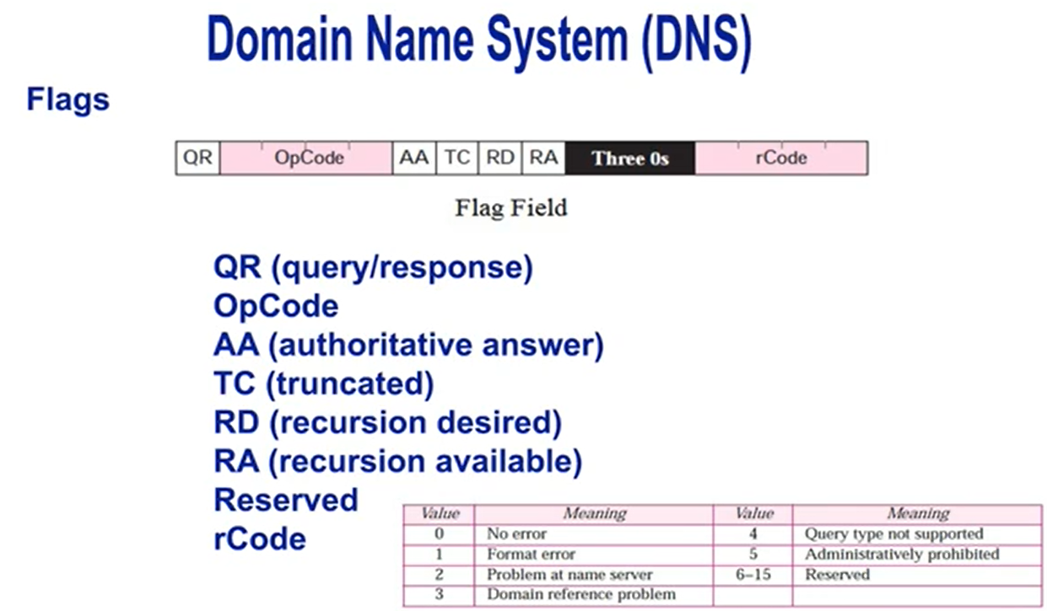
Extra

Slide 40
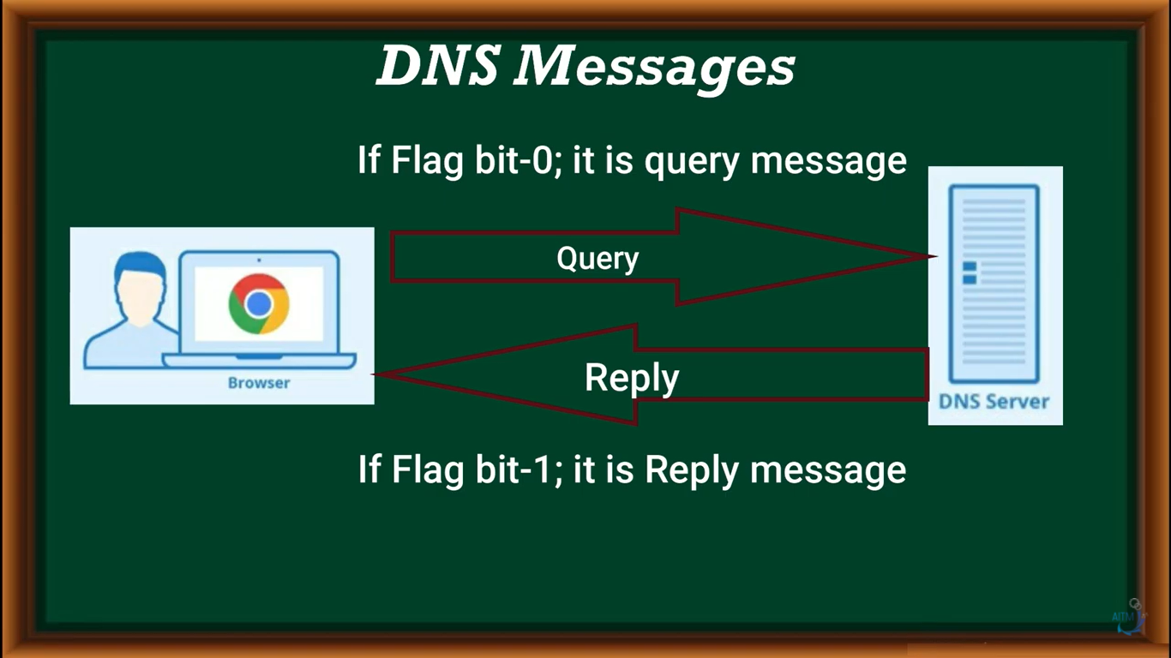

Slide 41
Flag Bits (Extra):
A brief description of each flag subfield follows.
a. QR (query/response): This is a 1-bit subfield that defines the type of message. If it is 0, the message is a query. If it is 1, the message is a response.
b. OpCode: This is a 4-bit subfield that defines the type of query or response (0 if standard, 1 if inverse, and 2 if a server status request).
c. AA (authoritative answer): This is a 1-bit subfield. When it is set (value of 1)it means that the name server is an authoritative server. It is used only in a response message.
d. TC (truncated): This is a 1-bit subfield. When it is set (value of 1), it means that the response was more than 512 bytes and truncated to 512. It is used when DNS uses the services of UDP (see Section 19.8 on Encapsulation).
e. RD (recursion desired): This is a 1-bit subfield. When it is set (value of 1) it means the client desires a recursive answer. It is set in the query message and repeated in the response message.
f. RA (recursion available): This is a 1-bit subfield. When it is set in the response, it means that a recursive response is available. It is set only in the response message.
g. Reserved: This is a 3-bit subfield set to 000.
h. rCode: This is a 4-bit field that shows the status of the error in the response.

Slide 42
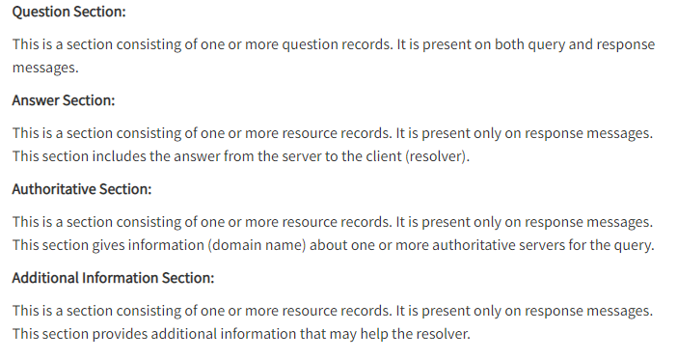
Header Format (Extra) cont

Slide 43
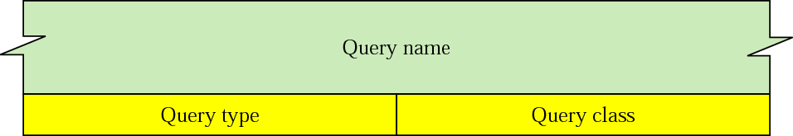
Types of records in DNS
DNS records are instructions that live in authoritative DNS servers and provide information about a domain including what IP address is associated with that domain and how to handle requests for that domain.
Two types of records are used in DNS:
The Question Records are used in the question section of the query and response messages
The Resource Records are used in the answer, authoritative, and additional information sections of the response message.
Figure : Question records

Slide 44
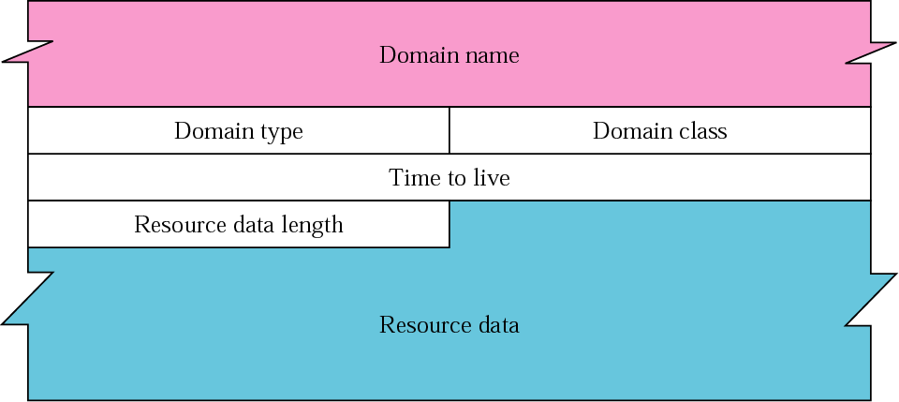
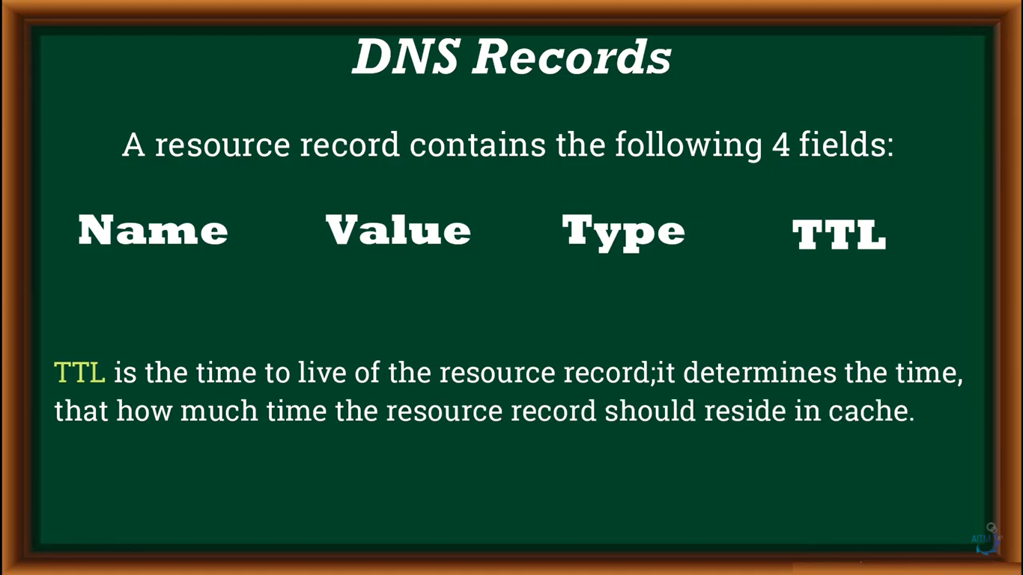
Resource record format
Figure : Resource records

Slide 45
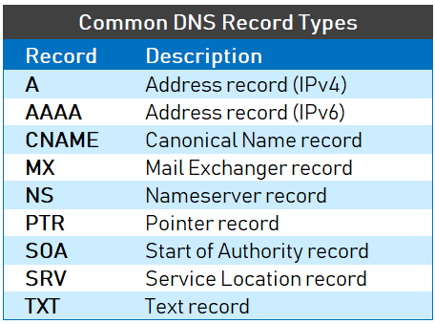

Slide 46
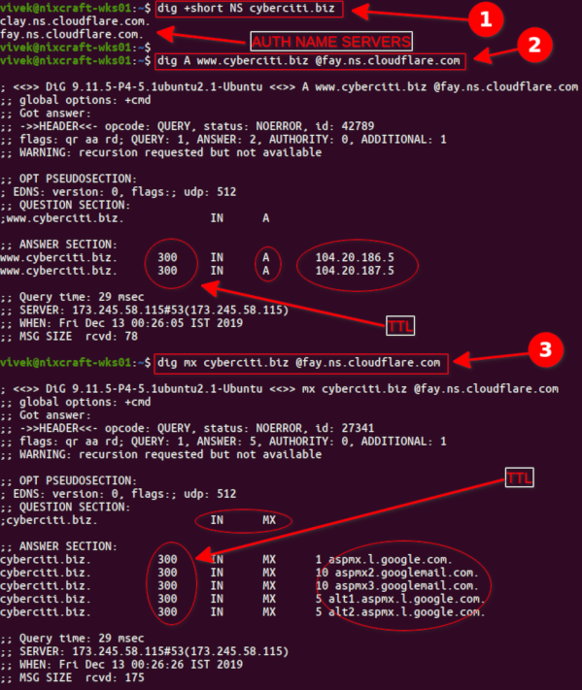
Extra: command: ipconfig/all

Slide 47
Dynamic Host Control Protocol
(DHCP)
https://www.youtube.com/watch?v=4pkDL1pgCgQ&t=122s

Slide 48




DHCP: Extra Information
Why IP Address is needed?
Manually given address as number of hosts are less
Special Host is called as DHCP Server
Dynamically given address as number of hosts are large

Slide 49


Dynamic Host Control Protocol (DHCP)
Each computer that uses the TCP/IP protocol suite needs to know its IP address. If the computer uses classless addressing or is a member of a subnet, it also needs to know its subnet mask.
Four pieces of information are normally needed:
1. The IP address of the computer
2. The subnet mask of the computer
3. The IP address of a router / Gateway
4. The IP address of a name server
These four pieces of information can be stored in a configuration file and accessed by the computer during the bootstrap process.
The DHCP client and server can either be on the same network or on different networks.

Slide 50


Slide 51



DHCP Client and Server on the same network
Figure : DHCP client and server on the same network

Slide 52

DHCP client and server on two different networks
Helper
Figure : DHCP client and server on two different networks

Slide 53

Use of UDP ports in DHCP
Why UDP?
Fast protocol and used in real time
Figure : Use of UDP ports in DHCP

Slide 54



DHCP Packet / Message Format
Figure : DHCP packet format

Slide 55


DHCP Packet / Message Format
Operation-
Hardware Type-For Ethernet set to 1
H/W length- for Ethernet it is set to 1 (MAC Address)
Hops: Number of routers in between Client and Server.
Transaction ID-Random 32 bit number-0x458DE5A3 generated by client to match between replies and requests.
Flags: 16 bit.
Set to 1 if broadcast
Set to 0 if unicast
CIP add: Current client IP address
YIP Add: Address given by server to client
Figure : DHCP packet format

Slide 56

Extra Information about: boot file --- DHCP Packet / Message Format

Slide 57


DHCP client transition diagram
Figure : DHCP client transition diagram

Slide 58

Exchanging Messages
Negative Acknowledgement (NACK)
Figure : DHCP message exchange diagram

Slide 59
SMTP: Simple Mail Transfer Protocol POP3: Post Office Protocol IMAP: Internet Message Access Protocol MIME: Multipurpose Internet Mail Extensions

Slide 60
Quiz
1. SMTP is a -------Protocol (Push/POP)
Push protocol
2. SMTP used to send the mail----True or False
True
3. POP and IMAP are -------protocol (Push/POP)
Pull
4. POP (post office protocol) or IMAP (internet message access protocol) are used to retrieve those emails at the receiver’s side. True or false
True
5. SMTP is an application layer protocol/Transport layer/Network Layer Protocol?
Application Layer Protocol
6. SMTP Port No? 25, 21, 20, 33
25
7. SMTP (Simple Mail Transfer Protocol) is a TCP/IP protocol used in sending and receiving e-mail. True/False
True.
8. MTA-----Abbreviation
Message Transfer Agent
9. UA-----Abbreviation
User Agent

Slide 61
SMTP: Simple Mail Transfer Protocol
Architecture and services
The user agent
Message formats
Message transfer
Final delivery

Slide 62
SMTP: Simple Mail Transfer Protocol (Port No. 25)
SMTP (Simple Mail Transfer Protocol) is a TCP/IP protocol used in sending and receiving e-mail.
SMTP is a push protocol and is used to send the mail
POP (post office protocol) or IMAP (internet message access protocol) are used to retrieve those emails at the receiver’s side.
SMTP is an application layer protocol.
The client who wants to send the mail opens a TCP connection to the SMTP server and then sends the mail across the connection.
The SMTP server is an always-on listening mode.
The SMTP process initiates a connection through port 25.
After successfully establishing a TCP connection the client process sends the mail instantly.

Slide 63


SMTP architecture and services
Figure : SMTP architecture and services

Slide 64
SMTP architecture and services
Figure : SMTP architecture and services

Slide 65
SMTP Architecture and Services
In the SMTP model user deals with the user agent (UA), for example, Microsoft Outlook, Netscape, Mozilla, etc.
In order to exchange the mail using TCP, MTA is used.
The user sending the mail doesn’t have to deal with MTA as it is the responsibility of the system admin to set up a local MTA.
The MTA maintains a small queue of mails so that it can schedule repeat delivery of mails in case the receiver is not available.
The MTA delivers the mail to the mailboxes and the information can later be downloaded by the user agents.
Figure : SMTP architecture and services

Slide 66


Simple Mail Transfer Protocol: POP3, IMAP, MIME
Figure : Format of an email

Slide 67
SMTP: Simple Mail Transfer Protocol
SENDING EMAIL:
Mail is sent by a series of request and response messages between the client and the server.
The message which is sent across consists of a header and a body.
A null line is used to terminate the mail header and everything after the null line is considered as the body of the message, which is a sequence of ASCII characters.
The message body contains the actual information read by the receipt.
RECEIVING EMAIL:
The user agent at the server-side checks the mailboxes at a particular time of intervals.
If any information is received, it informs the user about the mail.
When the user tries to read the mail it displays a list of emails with a short description of each mail in the mailbox.
By selecting any of the mail users can view its contents on the terminal.

Slide 68

SMTP : Simple Mail Transfer Protocol
SMTP is used two times, between the sender and the sender’s mail server and between the two mail servers
Figure : SMTP

Slide 69

SMTP
It pushes the message from the client to the server
On the other hand, the third stage needs a pull protocol
The client must pull messages from the server
The direction of the bulk data are from the server to the client.

Slide 70
Electronic mail : SMTP Summary
Uses TCP to reliably transfer email message from client to server (port 25)
Direct transfer: sending server to receiving server
Three phases of transfer
Handshaking (greeting)
Transfer of messages
Closure
Command/Response Interaction
commands: ASCII text
response: status code and phrase
Messages must be in 7-bit ASCII

Slide 71


https://www.youtube.com/watch?v=cjPVlxmf_Vk
Simple Mail Transfer Protocol: POP3, IMAP, MIME (Extra)
Client Based application:
MUA-Mail User Agent or client or sender
SMTP-To push mail from outlook to sender mail server
MSA-mail submission Agent (Error checking), Security checking
MTA-Mail Transfer Agent
MDA-Mail Delivery Agent
Sender
Receiver

Slide 72

Electronic Mail: Summary SMTP, POP3, IMAP (Extra)
Three major components
user agents
mail servers
simple mail transfer protocol: SMTP
User Agent
composing, editing, reading mail messages
e.g., Eudora, Outlook, elm, Mozilla Thunderbird
outgoing, incoming messages stored on server
Figure : SMTP working

Slide 73
Electronic Mail: Summary SMTP, POP3, IMAP (Extra)
Mail Servers
mailbox contains incoming messages for user
message queue of outgoing (to be sent) mail messages
SMTP protocol between mail servers to send email messages
client: sending mail server
“server”: receiving mail server
Figure : SMTP working

Slide 74

Scenario: Alice sends message to Bob
SMTP
SMTP
Alice
opens TCP connection with Bob’s mail server
Bob
1) Alice uses UA to compose message and “to” bob@someschool.edu
2) Alice’s UA sends message to her mail server; message placed in message queue
3) Client side of SMTP opens TCP connection with Bob’s mail server
4) SMTP client sends Alice’s message over the TCP connection
5) Bob’s mail server places the message in Bob’s mailbox
6) Bob invokes his user agent to read message

Slide 75
Comparison: HTTP and SMTP
SMTP requires message (header & body) to be in 7-bit ASCII
SMTP server uses CRLF. CRLF indicates a new line, i.e. a Carriage Return immediately. CRLF to determine end of message.
Comparison with HTTP:
HTTP: Pull
SMTP: Push
Both have ASCII command/response interaction, status codes
HTTP: Each object encapsulated in its own response message
SMTP: Multiple objects sent in Multipart message

Slide 76

POP3 (Post Office Protocol) and IMAP4 (Internet Message Access Protocol)
IMAP4 is similar to POP3, but it has more features;
IMAP4 is more powerful and more complex.
POP3 is deficient in several ways. It does not allow the user to organize her mail on the server; the user cannot have different folders on the server.
In addition, POP3 does not allow the user to partially check the contents of the mail before downloading.
IMAP4
Another mail access protocol is Internet Mail Access Protocol, version 4 (IMAP4)
IMAP4 is similar to POP3, but it has more features; IMAP4 is more powerful and more complex.
POP3 is deficient in several ways. It does not allow the user to organize her mail on the server; the user cannot have different folders on the server
In addition, POP3 does not allow the user to partially check the contents of the mail before downloading.

Slide 77
IMAP4 provides the following extra functions
A user can check the e-mail header prior to downloading.
A user can search the contents of the e-mail for a specific string of characters prior to downloading.
A user can partially download e-mail. This is especially useful if bandwidth is limited and the e-mail contains multimedia with high bandwidth requirements.
A user can create, delete, or rename mailboxes on the mail server.
A user can create a hierarchy of mailboxes in a folder for e-mail storage.

Slide 78

Comparison of POP3 and IMAP

Slide 79

Multipurpose Internet Mail Extensions (MIME)
Electronic mail has a simple structure. Its simplicity, however, comes with a price. It can send messages only in NVT (Network Virtual Terminal) 7-bit ASCII format.
In other words, SMTP has some limitations.
Multipurpose Internet Mail Extensions (MIME) is a supplementary protocol that allows non-ASCII data to be sent through e-mail. MIME transforms non-ASCII data at the sender site to NVT ASCII data and delivers it to the client MTA to be sent through the Internet. The message at the receiving site is transformed back to the original data.

Slide 80

MIME Extra

Slide 81

MIME (Extra)

Slide 82



MIME Header

Slide 83

Data Types and Subtypes in MIME

Slide 84
FTP: File Transfer Protocol
TFTP: Trivial File Transfer Protocol
TELNET : TErminaL NETwork
SNMP: Simple Network Management Protocol

Slide 85
File Transfer Protocol (FTP)
FTP uses two well-known TCP ports:
Port 21 is used for the control connection, and Port 20 is used for the data connection

Slide 86

File Transfer Protocol (FTP)
Port 21
Port 20
FTP uses two well-known TCP ports: Port 21 is used for the control connection,
and port 20 is used for the data connection

Slide 87
File Transfer Protocol (FTP)
File Transfer Protocol (FTP) is the standard mechanism provided by TCP/IP for copying a file from one host to another.
Although transferring files from one system to another seems simple and straightforward.
For example, two systems may use different file name conventions.
Two systems may have different ways to represent text and data.
Two systems may have different directory structures.
All of these problems have been solved by FTP in a very simple and smart approach.

Slide 88

FTP Connection

Slide 89


Opening the Control Connection
The control connection is created in the same way as other application programs
described so far. There are two steps:
1. The server issues a passive open on the well-known port 21 and waits for a client.
2. The client uses an ephemeral port and issues an active open.

Slide 90



Creating the Data Connection
1. The client, not the server, issues a passive open using an ephemeral port. This must be done by the client because it is the client that issues the commands for transferring files.
2. The client sends this port number to the server using the PORT command
3. The server receives the port number and issues an active open using the well known port 20 and the received ephemeral port number.
PORT command

Slide 91

Creating the Control and Data Connection (Extra Information)

Slide 92

Creating the Control and Data Connection (Extra Information)

Slide 93

File Management Commands

Slide 94

File Transfer Commands

Slide 95

Responses

Slide 96

File Transfer Commands
1. A file is to be copied from the server to the client (download). This is called retrieving a file. It is done under the supervision of the RETR (Retrieve file)command.
2. A file is to be copied from the client to the server (upload). This is called storing a file. It is done under the supervision of the STOR command.
3. A list of directory or file names is to be sent from the server to the client. This is done under the supervision of the LIST command. Note that FTP treats a list of directory or file names as a file. It is sent over the data connection.
upload
STOR command.
download
RETR command.
LIST command

Slide 97






Example of using FTP for retrieving a list of items in a directory
This protocol when used over PORT 8888 makes possible the transmission of a datagram message from one computer to an application running in another computer.

Slide 98
Using FTP for retrieving a list of items in a directory cont
1. After the control connection to port 21 is created, the FTP server sends the 220 (service ready) response on the control connection.
2. The client sends the USER command.
3. The server responds with 331 (user name is OK, password is required).
4. The client sends the PASS command.
5. The server responds with 230 (user login is OK).
6. The client issues a passive open on an ephemeral port for the data connection and sends the PORT command (over the control connection) to give this port number to the server.
7. The server does not open the connection at this time, but it prepares itself for issuing an active open on the data connection between port 20 (server side) and the ephemeral port received from the client. It sends response 150 (data connection will open shortly).

Slide 99
Using FTP for retrieving a list of items in a directory cont
8. The client sends the LIST message.
9. Now the server responds with 125 and opens the data connection.
10. The server then sends the list of the files or directories (as a file) on the data connection.
When the whole list (file) is sent, the server responds with 226 (closing data connection) over the control connection.
11. The client now has two choices. It can use the QUIT command to request the closing of the
control connection or it can send another command to start another activity (and eventually open another data connection). In our example, the client sends a QUIT command.
12. After receiving the QUIT command, the server responds with 221 (service closing) and then closes the control connection.

Slide 100

Trivial File Transfer Protocol (TFTP)
Trivial meaning: little worth or importance
Port 69

Slide 101
Trivial File Transfer Protocol (TFTP)
There are occasions when we need to simply copy a file without the need for all of the features of the FTP protocol. For example, when a diskless workstation or a router is booted, we need to download the bootstrap and configuration files. Here we do not need all of the sophistication provided in FTP. We just need a protocol that quickly copies the files.
Trivial File Transfer Protocol (TFTP) is designed for these types of file transfer.
It is so simple that the software package can fit into the read-only memory of a diskless workstation.

Slide 102
Trivial File Transfer Protocol (TFTP)
TFTP is good for simple file transfers, such as during boot time.
It uses UDP and basic IP and can operate out of ROM.
It uses the well-known Port 69.
TFTP can read or write a file for the client. Reading means copying a file from the server site to the client site. Writing means copying a file from the client site to the server site.

Slide 103



TFTP Uses 5 types of Message categories
RRQ – Read Request: used to establish a connection for reading data from a server
WRQ – Write Request
DATA – used to client or server to send blocks of data

Slide 104

RRQ format
RRQ – Read Request
Mode: defines the type of the file transferred “net ascii” for an ASCII file; “octet” for a binary file

Slide 105


WRQ format and Data format
Write Request
WRQ format
Data format

Slide 106


ACK and Error format
ACK format
Error format

Slide 107
Difference Between FTP and TFTP
FTP | TFTP
FTP uses two connection | TFTP uses one conection
Provide many commands | Provide only five commands
Uses TCP | Uses UDP
Client must login to server | No login procedure
Allow for user authentication | TFTP does not allow for user authentication
FTP provide reliable service | Unreliable
21- control, 20-data | Port 69

Slide 108
TELNET
(TErminaL NETwork)
https://www.youtube.com/watch?v=2JjILZPOC5g

Slide 109

TELNET Port 23
TELNET is an abbreviation for TErminaL NETwork
TELNET is a protocol that provides “a general, bi-directional, eight-bit byte oriented communications facility”.
Telnet is a program that supports the TELNET protocol over TCP.
Many application protocols are built upon the TELNET protocol.
TELNET enables the establishment of a connection to a remote system

Slide 110

TELNET

Slide 111






Remote Login
NVT

Slide 112

Local Login

Slide 113
Working of TELNET

Slide 114

Remote Login

Slide 115

Concept of Network Virtual Terminal
intermediate representation of a generic terminal
provides a standard language for communication of terminal control functions

Slide 116
TELNET
Reference: RFC 854
TCP connection
Data and Control over the same connection.

Slide 117
Command Structure
All TELNET commands and data flow through the same TCP connection.
Commands start with a special character called the Interpret as Command escape character
The IAC code is 255.
If a 255 is sent as data - it must be followed by another 255.
If IAC is found and the next byte is IAC
a single byte is presented to application/terminal
If IAC is followed by any other code
the TELNET layer interprets this as a command.

Slide 118
Playing with TELNET
You can use the telnet program to play with the TELNET protocol.
telnet is a generic TCP client.
Sends whatever you type to the TCP socket.
Prints whatever comes back through the TCP socket
Useful for testing TCP servers (ASCII based protocols).
Many Unix systems have these servers running (by default):
echo port 7 discard port 9
Daytime port 13 chargen port 19

Slide 119


Slide 120



Slide 121
Simple Network Management Protocol SNMP
https://www.youtube.com/watch?v=Lq7j-QipNrI
https://www.youtube.com/watch?v=2IXP0TkwNJU

Slide 122


Simple Network Management Protocol: SNMP concept
The Simple Network Management Protocol (SNMP) is a framework for managing devices in an internet using the TCP/IP protocol suite.
It provides a set of fundamental operations for monitoring and maintaining an internet. Like Hub, Switch, Router, Bridge

Slide 123

Simple Network Management Protocol (SNMP)
Functions performed by a network management system can be divided into five broad categories: Configuration management, Fault management, Performance management, Security management, and Accounting management.
SNMP generally uses User Datagram Protocol (UDP) port number 161 for sending commands and messages.

Slide 124

Components of Network Management on the Internet
SNMP, Structure of Management Information (SMI) and Management Information Base (MIB)
Simple Network Management Protocol
Structure of Management Information
Management Information Base

Slide 125
SMI and MIB
SMI defines the general rules for naming objects, defining object types (including range and length), and showing how to encode objects and values.
SMI does not define the number of objects an entity should manage or name the objects to be managed or define the association between the objects and their values.
MIB creates a collection of named objects, their types, and their relationships to each other in an entity to be managed.

Slide 126

Object Identifier
SMI uses an object identifier, which is a hierarchical identifier based on a tree structure
All objects managed by SNMP are given an object identifier.
The object identifier always starts with 1.3.6.1.2.1.

Slide 127

Object Identifier (OID)

Slide 128

Conceptual Data Types
SMI defines two structured data types: sequence and sequence of:
A sequence data type is a combination of simple data types, not necessarily of the same type
Sequence of data type is a combination of simple data types all of the same type

Slide 129


Management Information Base, version 2 (MIB2)
The Management Information Base, version 2 (MIB2) is the second component used in network management.
Each agent has its own MIB2, which is a collection of all the objects that the manager can manage.
This number

Slide 130


Slide 131










SNMP PDUs
Router/ Hub / Server/ Switch/ Bridge

Slide 132


SNMP PDU format
SNMP message

Slide 133
SNMP message

Slide 134

Port numbers for SNMP
Port 58000CP port 58000 uses the Transmission Control Protocol.
TCP port 61150 uses the Transmission Control Protocol.
https://www.adminsub.net/tcp-udp-port-finder/61150

Slide 135
References
Text Books:
Behrouz A. Forouzan, ‘Data Communications and Networking’, 5th Edition, McGraw-Hill Publishing Company, ISBN 978-0-07-337622-6
Tanenbaum A. S., ‘Computer Networks’, Pearson Education , 5th Edition, ISBN-978-0-13-212695-3
Reference Books:
James F. Kurose and Keith W Ross ‘Computer Networking, A Top-Down Approach’, 5th Edition, Pearson Education, ISBN- 978-81-317-9054-0
W. Richard Stevens, Unix Network Programming, The Sockets Networking API, Vol 1, 3rd Edition, PHI Learning Pvt. Ltd.
Supplementary Reading:
William Stallings, ‘Data and Computer Communications’, 6th Edition, Prentice Hall of India Pvt.
Web Resources:
https://nptel.ac.in/courses/106/105/106105080/
https://nptel.ac.in/courses/106/106/106106091/
Web links:
https://nptel.ac.in/courses/106/105/106105081/
https://nptel.ac.in/courses/106/105/106105183/
https://ocw.mit.edu/courses/electrical-engineering-and-computer-science/6-829-computer-networks-fall-2002/index.htm
MOOCs:
https://www.coursera.org/learn/computer-networking
https://www.edx.org/course/introduction-to-networking?index=product&queryID=0befdc538866babf2facfdc2dce06204&position=1

Slide 136
Questions
What is HTTP?
What are the basic Features of HTTP?
What are request methods in HTTP ?
Differentiate between persistent and non persistent HTTP connection ?
Explain HTTP caching ?
Define and Explain DNS ?
Explain DNS Query and response messages ?
Explain how name resolution happens in DNS. Enlist all the resource records and its function ?
DNS uses UDP instead of TCP. If a DNS packet is lost, there is no automatic recovery. Does this cause a problem, and if so, how is it solved?
Can a computer have two DNS names that fall in different top-level domains? If so, give a plausible example. If not, explain why not ?
Explain DHCP.
Explain DHCP packet format

Slide 137
Questions
13. Explain the function of E-mail system.
14. Explain E-mail system along with SMTP, POP3 and IMAP 4 protocol
15. When web pages are sent out, they are prefixed by MIME headers. Why?
16. List the similarities and differences between POP3 and IMAP.
17. Explain File Transfer Protocol.
18. Explain data connection and control connection in FTP
19. Compare between FTP and TFTP.
20. Why does it need an PRQ or WRQ message in TFTP but not in FTP
21. Explain TELNET
22. Enlist functions of Network Management System
23. Explain Structure of Management Information (SMI)
24. Write a note on Management Information Base

Slide 138
Thank You
Any Questions

